Slide 1









Garde Manger
Team 4 - CerealKillers
Alanah A., Alex G., Diego M., Tobias M., Yiqi L.

Slide 2




Progress Update
Recipe Database Setup
Recipe Generation Algorithm
Brand Scheming
10/7
10/18
Finished 10/14
YOU ARE HERE
9/30
10/11
Login, Signup
Pantry Setup
Midterm Presentation

Slide 3



Brand Scheming
Garde Manger
Regular text font: Albert Sans
Notes:
Alex

Slide 4

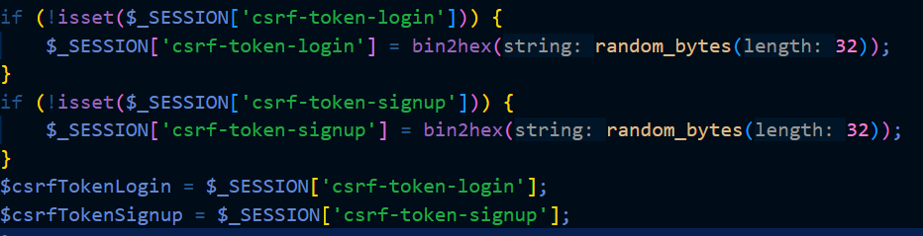

Login, Signup
Established secure login and signup process for web page
Utilized csrf-token to authenticate sessions
Utilized nonce values for inline javascript
Notes:
Alanah :D

Slide 5


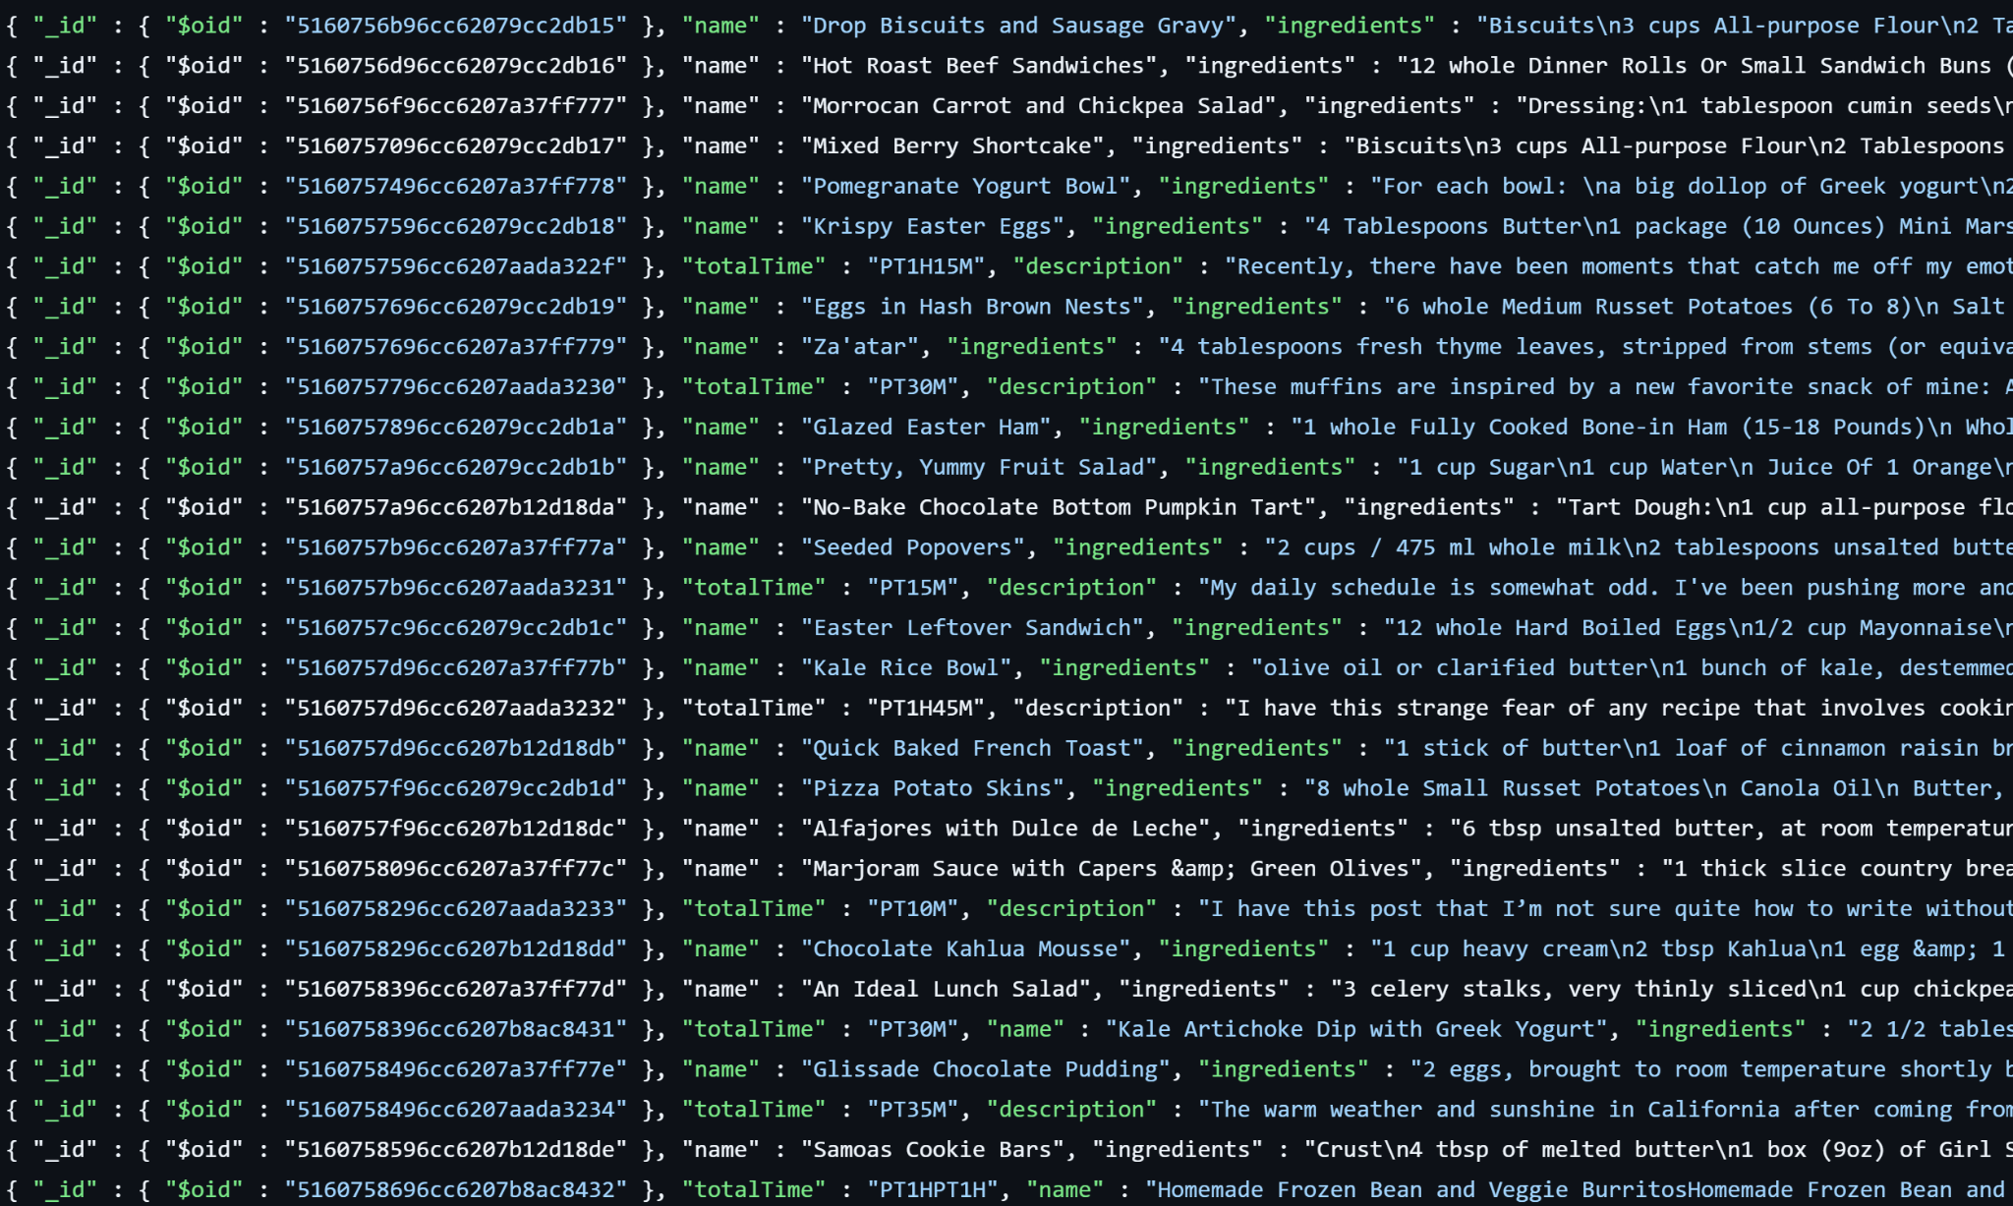
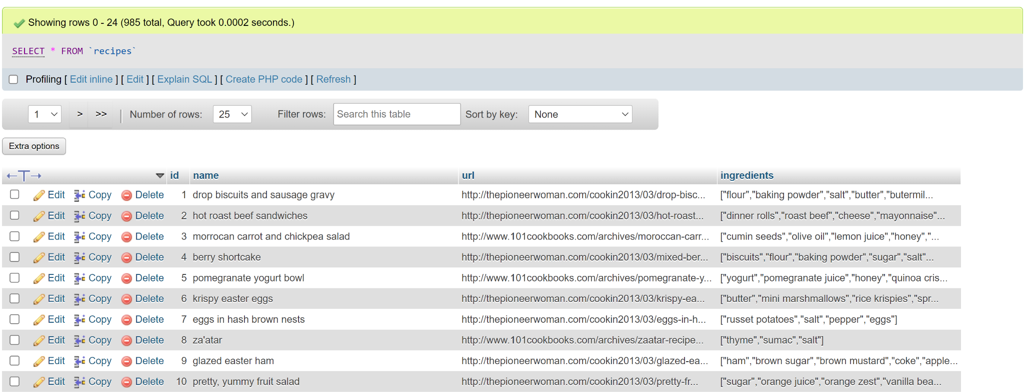

Recipe Database Setup
Searching for a recipe API
Sifting through recipe fields
Ensuring consistent recipe records

Slide 6
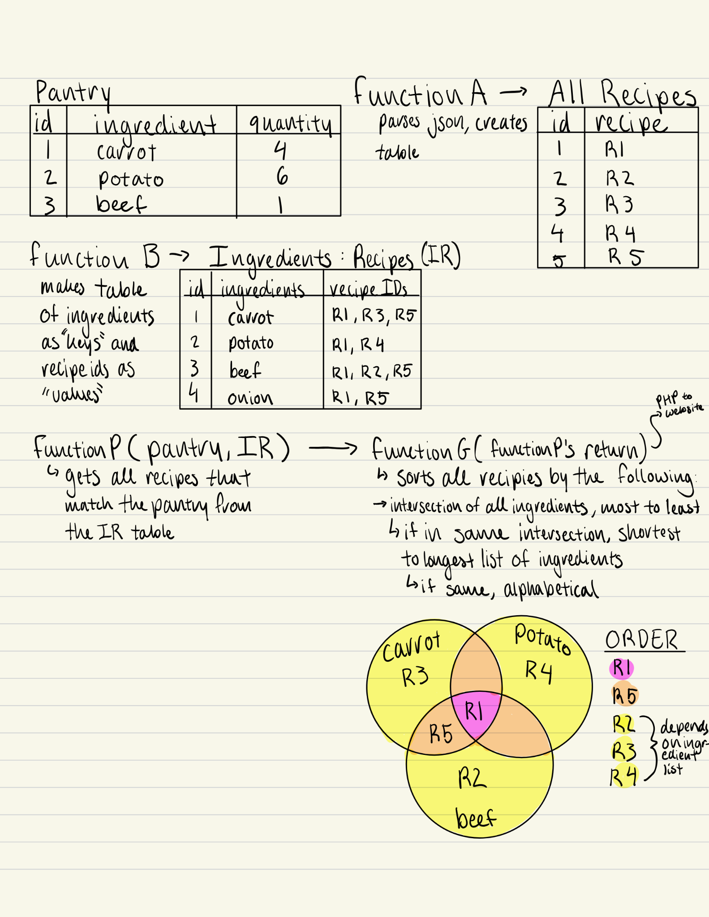

Recipe Generation Algorithm
Determining ranking criteria
Ingredient specificity conflicts
Drafting generator tables and functions

Slide 7

Future Endeavors
Front end overhaul
Security enhancements
Additional QOL features
Further backend testing
SEE THE ANSWER
Notes:
Front end overhaul: coherent CSS overhaul + animations + virtual pantry design
Security enhancements: Implement session management and headers to all pages on the site Additional QOL: dietary restrictions, shopping list, recipe creation
Further backed testing: multiple users

Slide 8





Quick Demo

